Slide 1
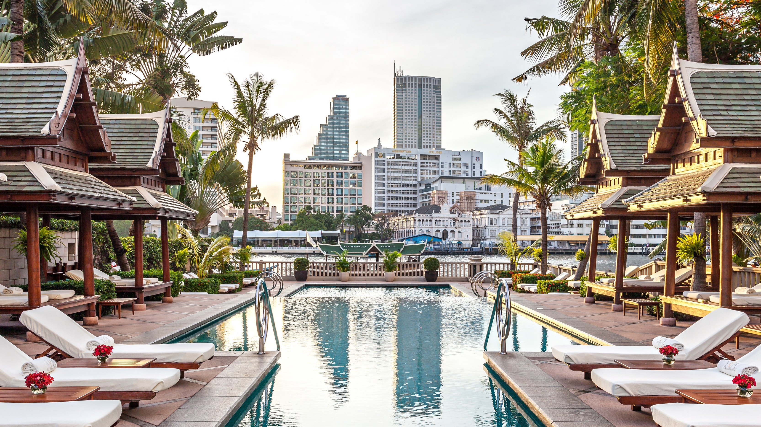
HOTEL REVENUE MANAGEMENT ANALYSIS

Slide 2

OUTLINE
1.Executive Summary
2.Introduction
3.Methodology
4.Result
4.1.Charts
4.2.Dashboard
5.Discussion
6.Conclusion
7.Appendix

Slide 3
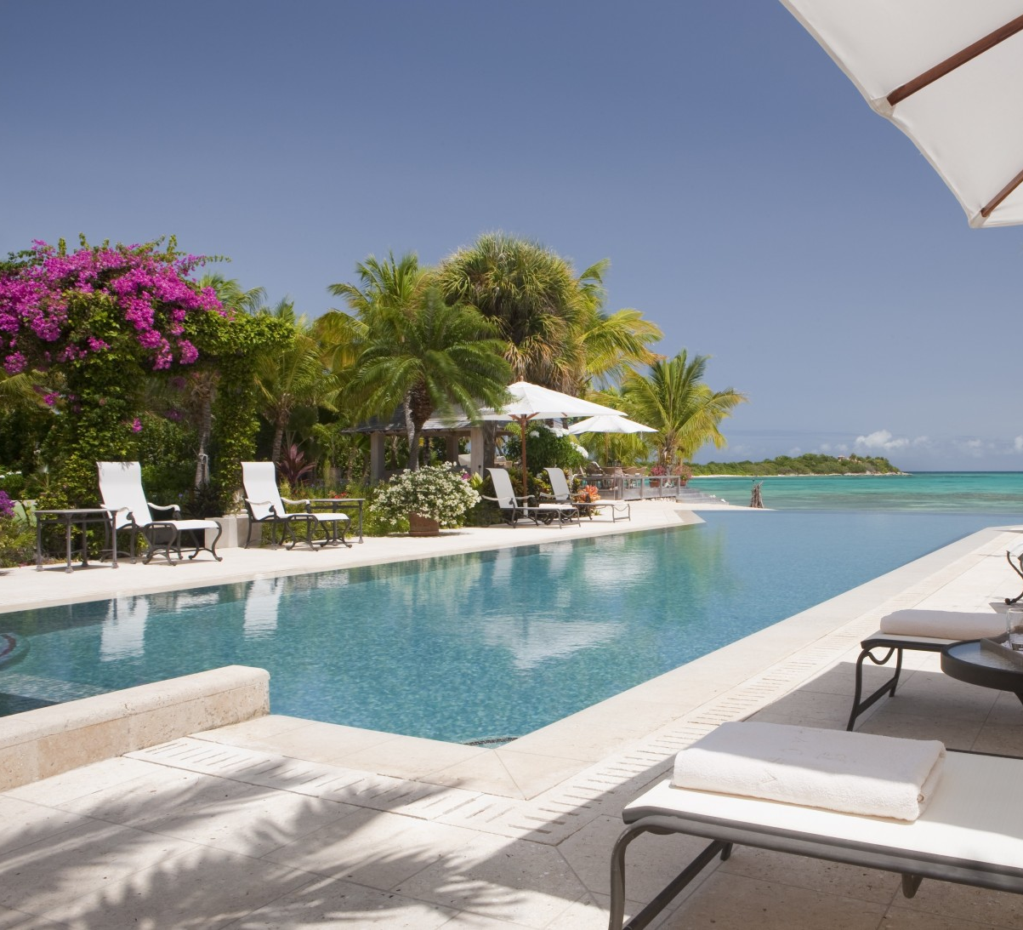
1.EXECUTIVE SUMMARY
Overview about Hotel Revenue Management
(Revenue, ADR…).
Hotel Revenue (City Hotel and Resort Hotel) by year.

Slide 4
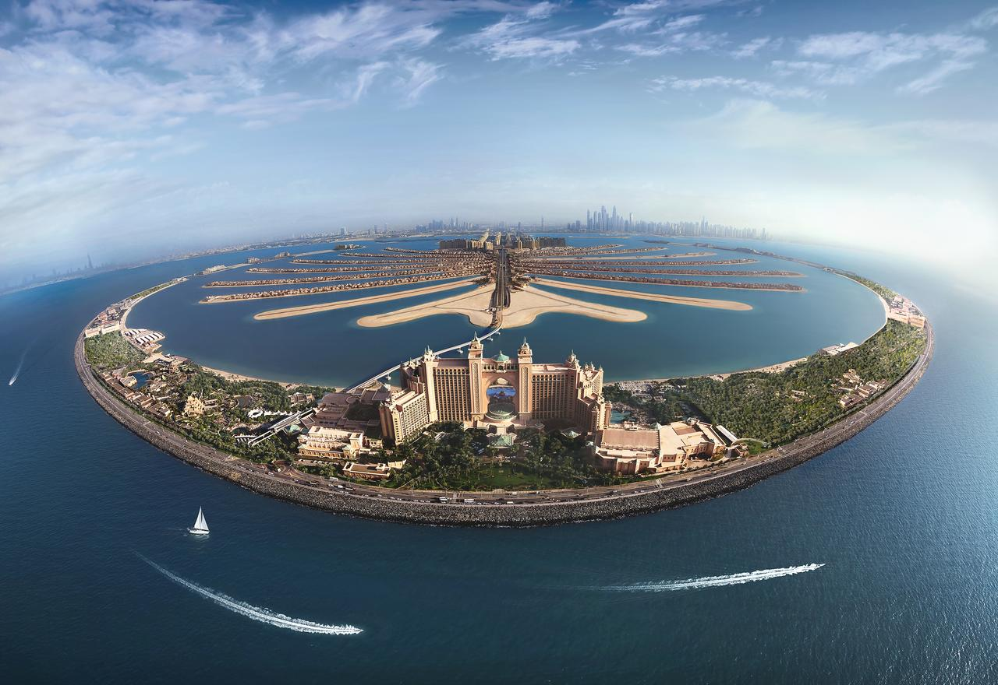
2.INTRODUCTION
Specify total revenue, average of ADR, average discount and car spaces.
Compare the difference between City Hotel and Resort Hotel. How does it affect revenue?
Impact of Covid-19 on the Travel Industry.

Slide 5

3.METHDOLOGY
Data Collection
+ Collecting Data from website (Appendix)
Data Wrangling
+ Using Union (SQL) to combine data from multiple csv files
- Exploratory Data Analysis
+ Analyze, explore data (using CTEs, Join…)

Slide 6
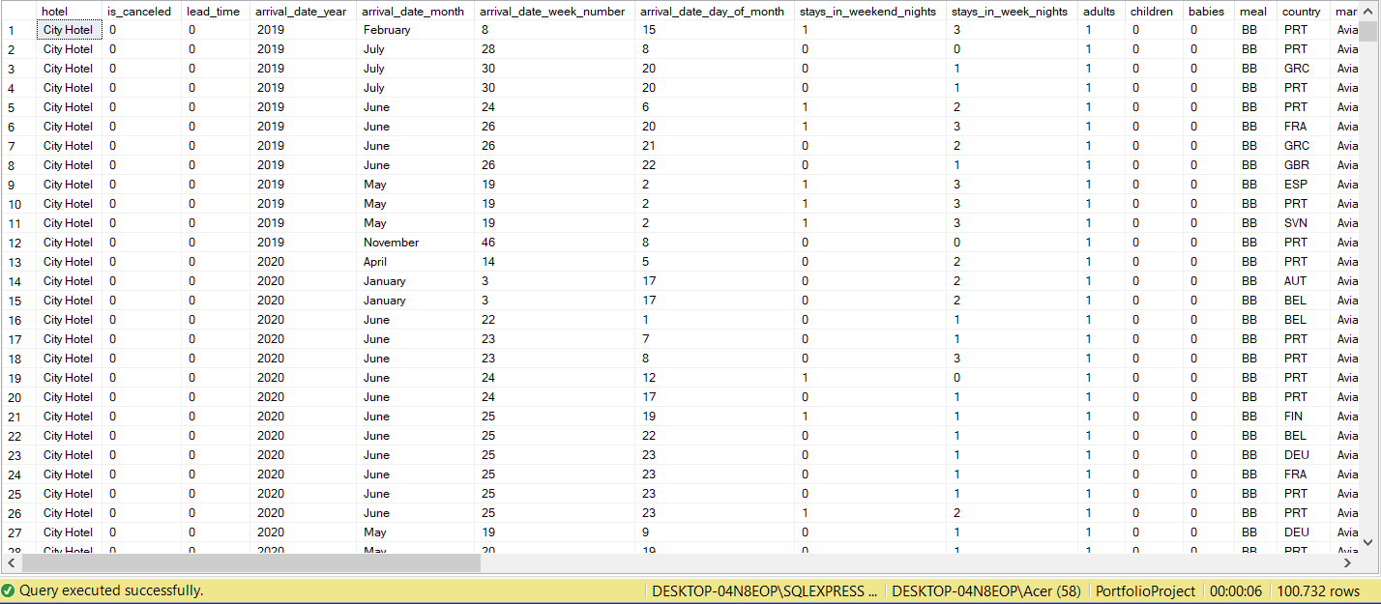
4.RESULT

Slide 7
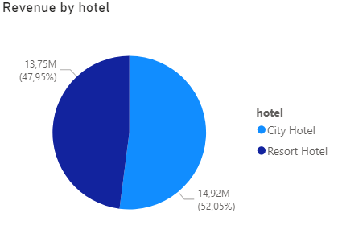
4.1.CHART
From 2018 to 2020, Total Revenue is 28,67M. City Hotel accounts for 52,05% and Resort Hotel is 47,95%.
Average of Adr (Average Daily Rate) and average discount respectively is 104,6 and 25,8 %. Total number of required car parking spaces are 8425 in 2020.

Slide 8
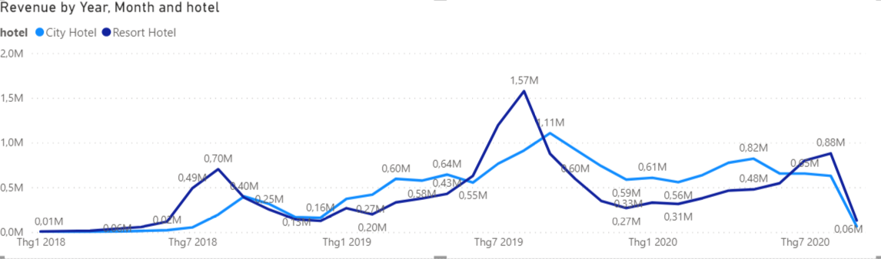
4.1.CHART
From 2018 to 2020, there are 3 times the resort revenue increases significantly. It occurs in August 2018,2019,2020. It’s summer vacation and attract vacationers who planing a long vacation with the family or want to fully relax.
The revenue of City Hotel increased steadily until end of 2019. Because hotels focus on travellers in general. This can include tourists, business people... with many activities like shopping, spa or event, conference for business people. These activities take place all year round and it make revenue increase steadily.

Slide 9
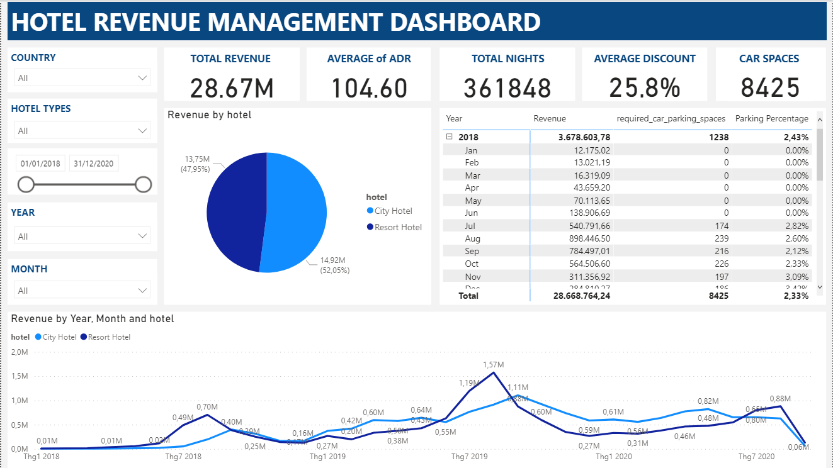
4.2.DASHBOARD

Slide 10

5.DISCUSSION
What’s the difference between City Hotel and Resort Hotel. How does it affect Travel Industry?
How to deal with challenges of Covid-19 in Travel Industry?

Slide 11
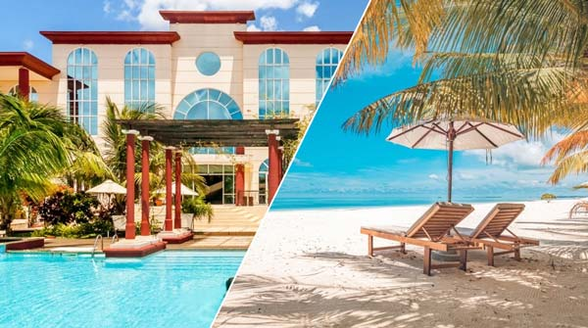
DIFFERENCE BETWEEN HOTEL AND RESORT
A hotel is a place near the center downtown that provides lodgings, or sleeping accommodations, to its patrons.
A resort is a space, similar to a hotel, that offers relaxation or recreation to its patrons. The activities in here depend upon the environment (rainforest, beach…).
Hotels cater to travellers who need a place to spend the night at a certain destination. Resorts often have a more spacious layout, offering their guests everything they need in one place.

Slide 12

Impact of Covid-19 on the Travel Industry
In 2020, because of Covid-19 both of the revenue of City Hotel and Resort Hotel decreased.
Revenue decreased from 6,1 million $ in 1/2020 to 64509 $ in 9/2020 for Hotel City. For Resort City, the number decreased from 3,3 million $ to 130000 $ at the same time.

Slide 13
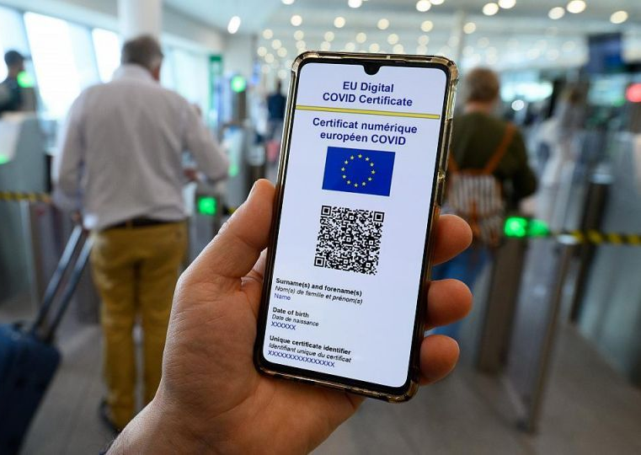
SOLUTION
Focus on developing domestic tourism.
Use vaccination certificates.
Apply preferential policies to customers
Encourage customers using food service at room

Slide 14
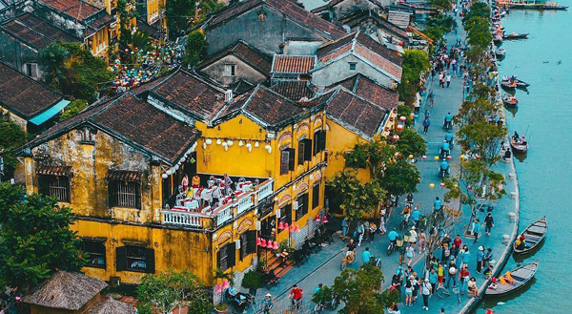
6.CONCLUSION
Travel activities at the Resorts are popular during the summer vacation and it brings large revenue.
Beside travel, activities like event organization, conference… contribute to increase revenue steadily at the Hotels.
Because Covid-19, both of the revenue of Resort and Hotel decrease. So we need particular solution to recovery for the Travel Industry.

Slide 15
7.APPENDIX
Link Dataset from:
https://www.absentdata.com/hotel_revenue_historical_full/
More information about the difference between resorts and hotels:
https://www.beaches.com/blog/resorts-vs-hotels/

